Slide 1

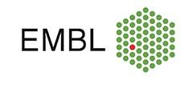



Image analysis: what and how?
David Legland
Advanced methods in bioimage analysis
Heidelberg, 10 – 15 Sep 2023

Slide 2
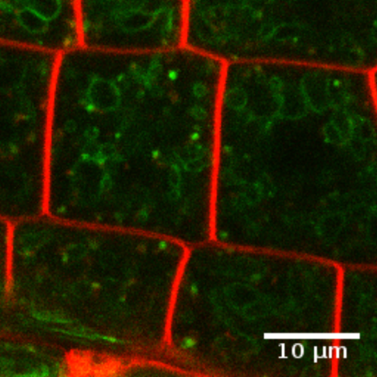
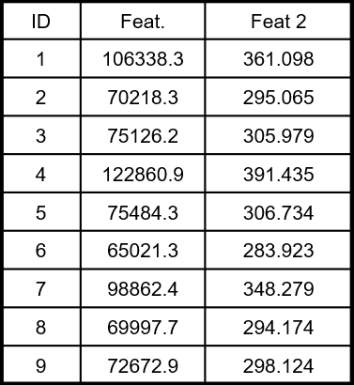
Why Image Analysis?
Generation of large quantity of imaging data
Objectives:
Exploration
Illustration
Visual comparison
Statistical comparison
Classification
Modelling
…
Need to quantify information within images
Analysis
Image
Measures

Slide 3
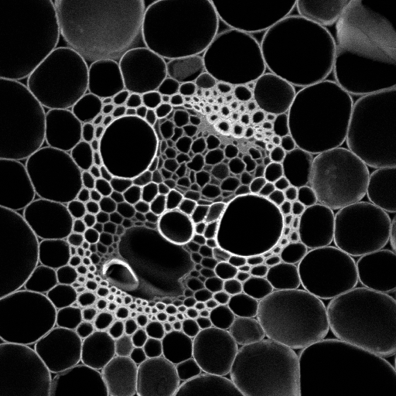
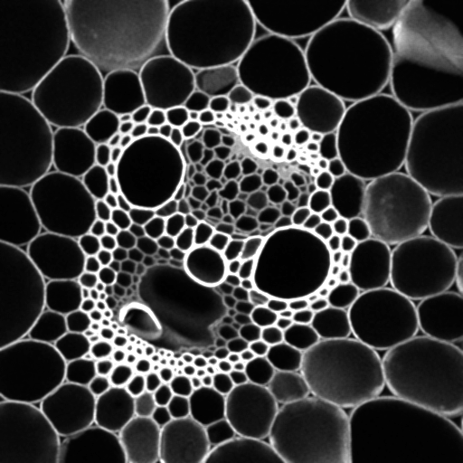
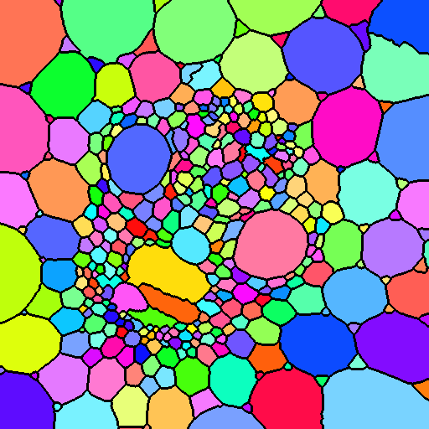
Image analysis workflow (simplified!)
Filtering &
enhancement
Segmentation
Analysis
nom | Aire | Diamètre
1 | 106338.3 | 361.098
2 | 70218.3 | 295.065
3 | 75126.2 | 305.979
4 | 122860.9 | 391.435
5 | 75484.3 | 306.734
6 | 65021.3 | 283.923
7 | 98862.4 | 348.279
8 | 69997.7 | 294.174
9 | 72672.9 | 298.124
Original image
Filtered image
Segmented image
Results table

Slide 4
What I will talk about
What can we quantify from images?
It depends on the image/on the topic
Often focus on regions, but not always appropriate
-> overview of cases
How can we quantify?
What are the mathematical basis of image analysis?
What are the limits?

Slide 5
Outline
Introduction
What can we quantify?
Regions
Point patterns
Microstructures
Textures
…
How can we quantify?

Slide 6
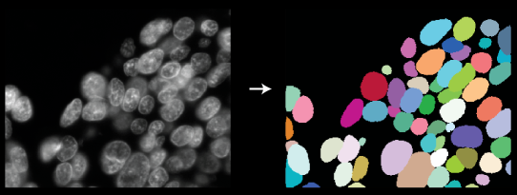
Analysis of regions
Usually the “main” case of image analysis
Regions:
A set of pixels/voxels associated to the same class
Regions correspond to cells, objects, organs…
Usually obtained by (manual or automated) segmentation
Often represented as “label maps”

Slide 7
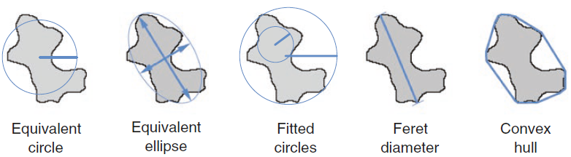
Analysis of regions: morphometry
“Morphometry”: measuring the morphology
Size + Shape
“Size” -> how large is the region
Area
Perimeter
Thickness
Diameter(s)
Feret
Geodesic
Equivalent shape
…
Legland and Beaugrand (2013)
Arganda-Carreras and Andrey (2017)

Slide 8
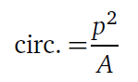
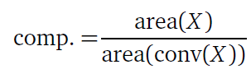
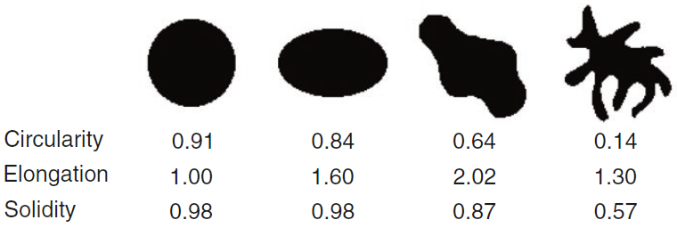
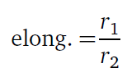
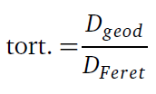
Shape factors / indices
Shape:
“what remains independently of position, rotation and size”
Often quantified via ratio of size features

Slide 9
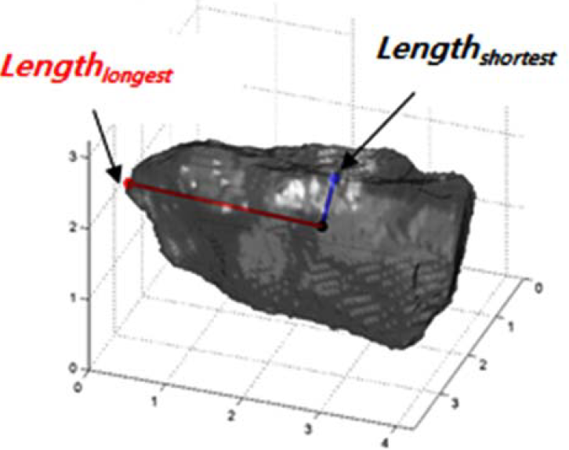
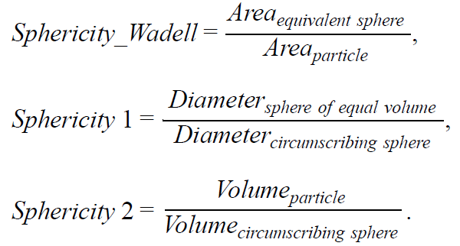
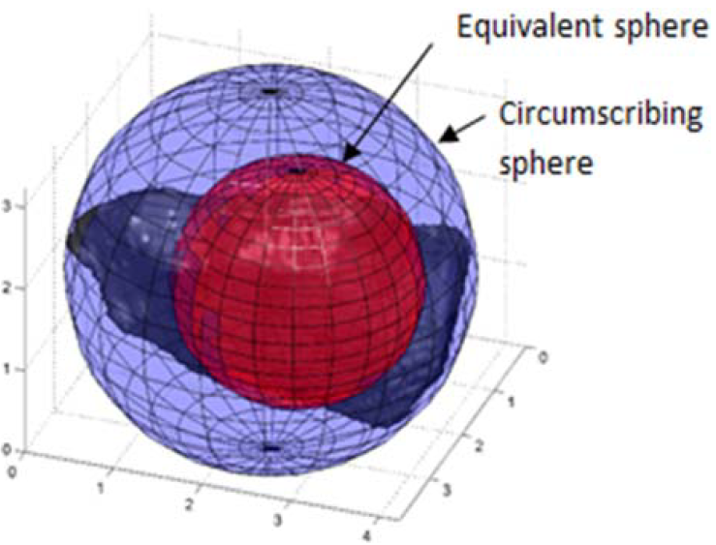
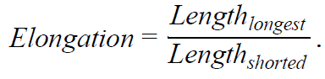
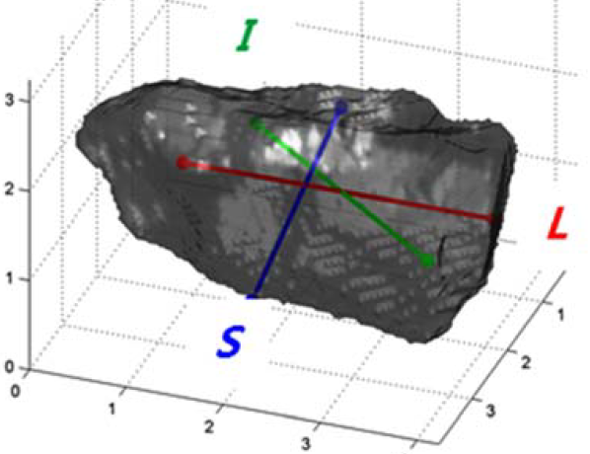
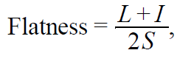
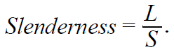
Shape indices for 3D regions

Slide 10
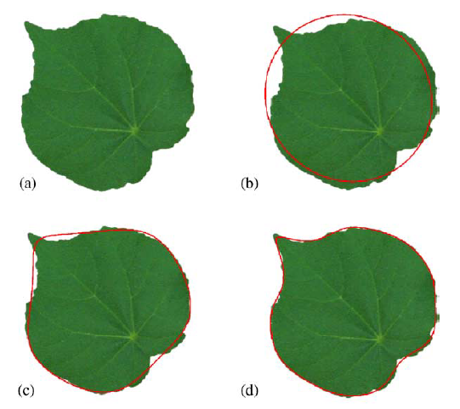
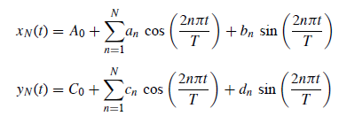
Region outline analysis – Elliptical Fourier Descriptors
Idea:
Consider the region contour / outline
Apply Fourier transform
Keep adequate number of harmonics
C(t) = ( x(t) , y(t) )
Iwata H & Ukai Y (2002)
Neto et al, (2006) Computers and Electronics in Agriculture

Slide 11
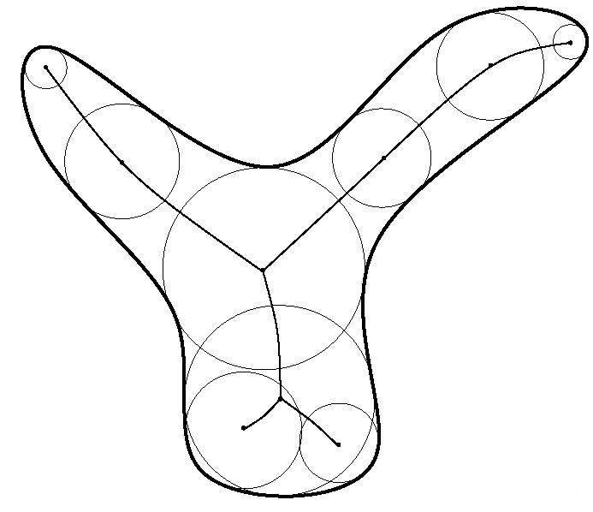
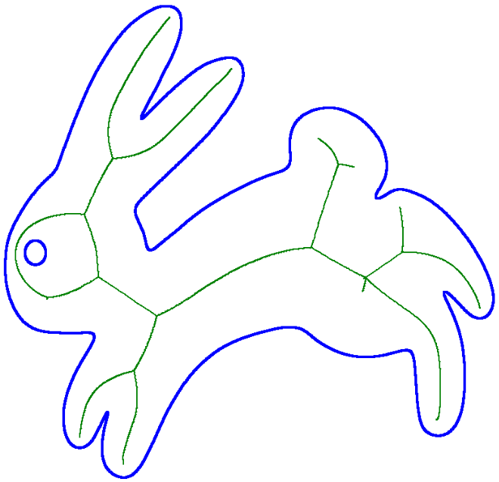
Skeleton analysis
Skeleton / medial axis:
Set of the centres of disks that touch the boundary at more than one point
Skeleton analysis:
Number / size of branches, topology…

Slide 12
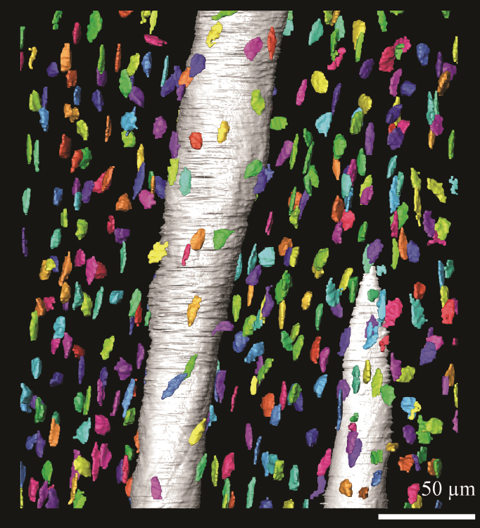
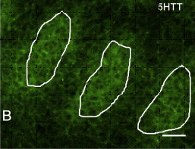
Analysis of regions: more than morphology
Intensities / colours
Orientations
Spatial organizations
…

Slide 13
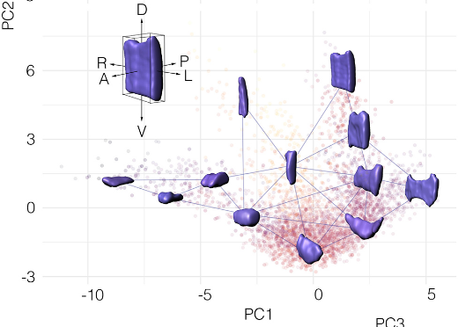
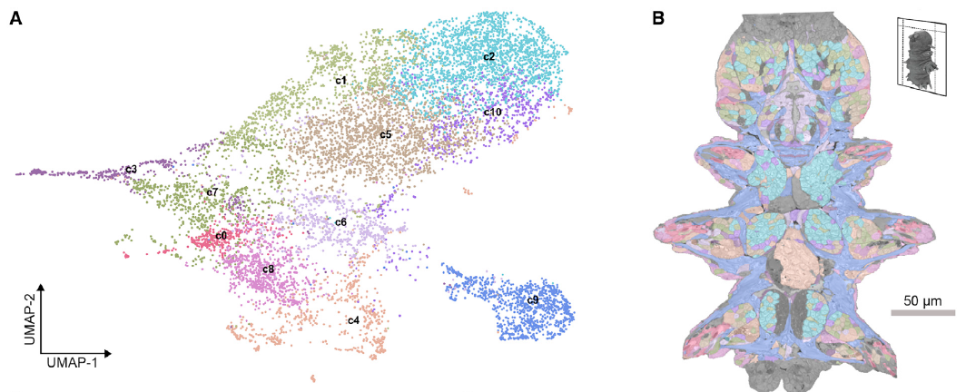
Classification of regions based on their morphology
Principles:
Extract features
Optionally combine with other features
Intensity
Texture
…
Unsupervised
PCA+K-means, HCA, t-SNE…
Supervised
K-means, SVM, CNN…
Andrews et al. (2021)
Vergara et al., (2021)
Zitchenko et al. (2023)

Slide 14
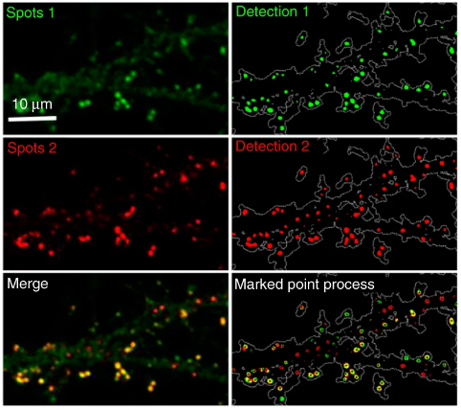
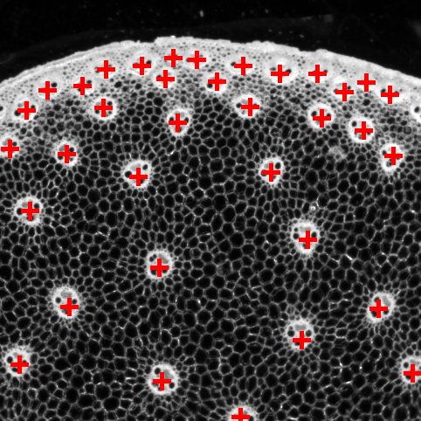
Analysis of “positions” -> point pattern analysis
Structures of interests are points (in 2D, 3D…)
Examples:
Markers within cell
Cells within tissue
Tissues within organ
…
Related questions :
Number
Densities (local, global)
Spatial organization:
Clustering, repulsion…
Modeling

Slide 15
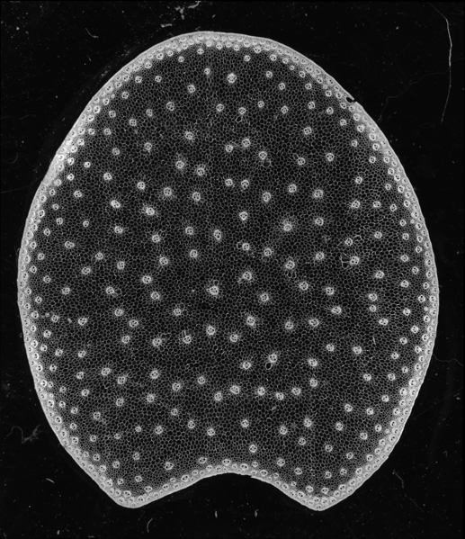
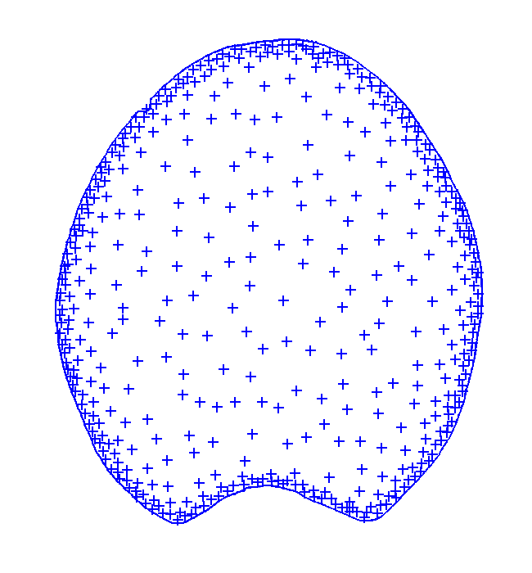
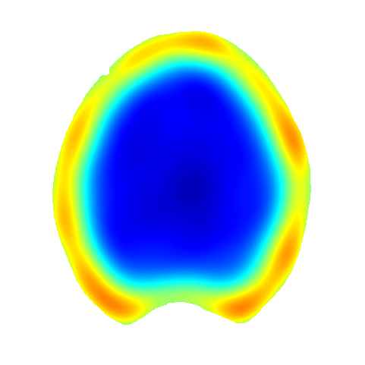
Point pattern analysis – density maps
Detection of points (here, of bundles) within tissue
Evaluate expected number of points wrt location
Parzen window, K-NN…

Slide 16
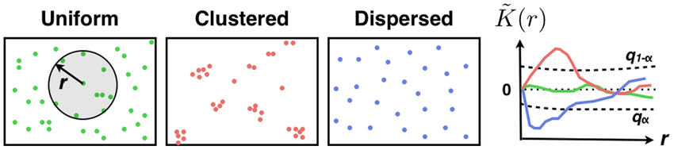
Point pattern analysis – summary statistics
How are the points organized?
“Regular”, clusters, repulsion…
Analysis by means of summary functions
E.g. “Ripley’s K function”
Other functions: F, G, H, L…
Cressie (1991); Lagache et al. (2013), PlosONE
Behanova et al. (2022) Front. Physiol

Slide 17
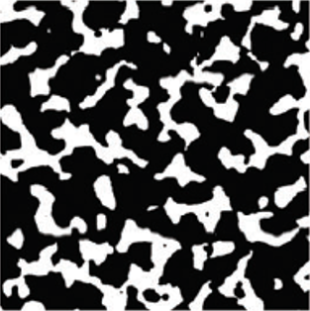
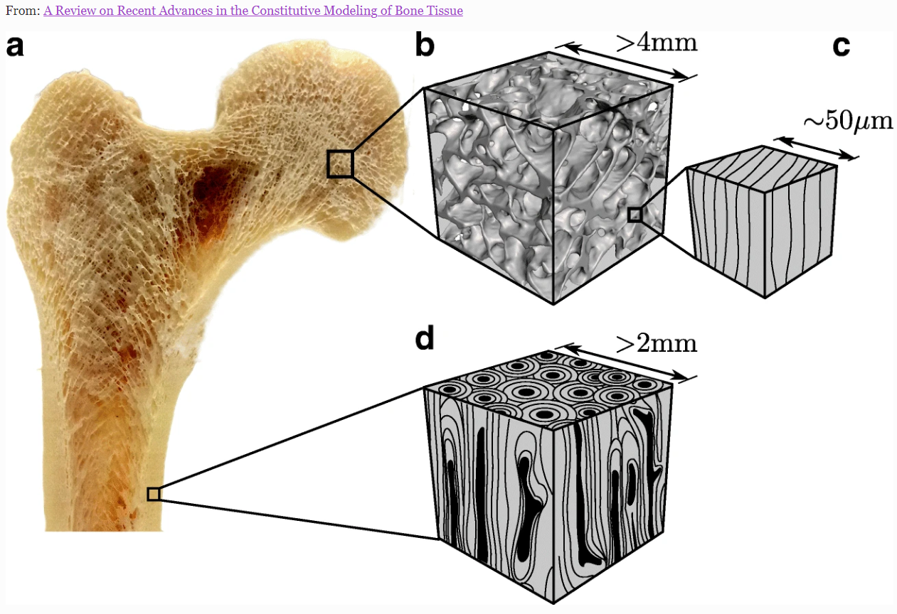
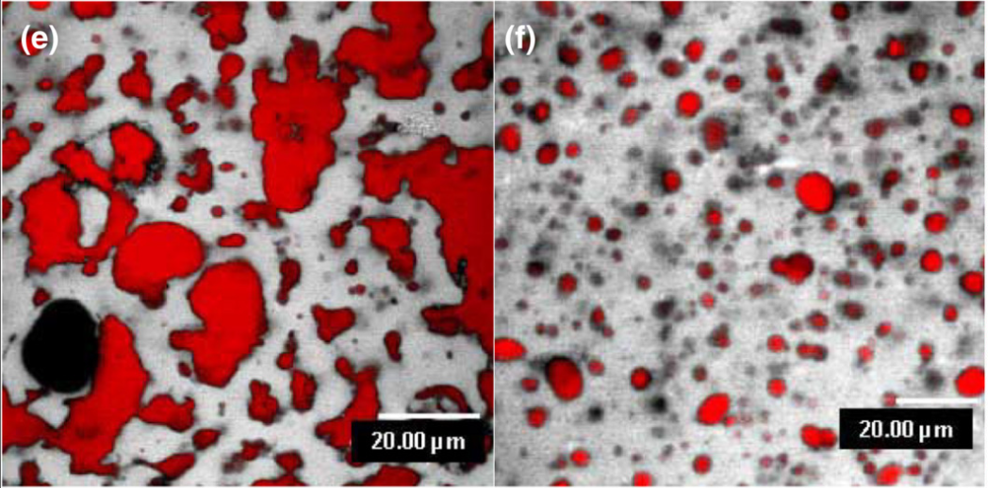
“Binary microstructures”, porous media
Structure composed of two phases, possibly interconnected
Porous media/material: material containing a large number of pores
Examples
Material sciences
Bone, lung
Bread, cheese
…
Considered as binary images
Emmental & Camembert Cheese
Bone microstructure,
from https://doi.org/10.1007/s11914-020-00631-1
Feeney el al., 2021

Slide 18
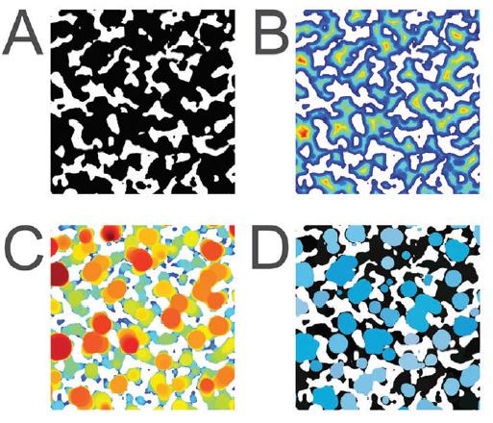
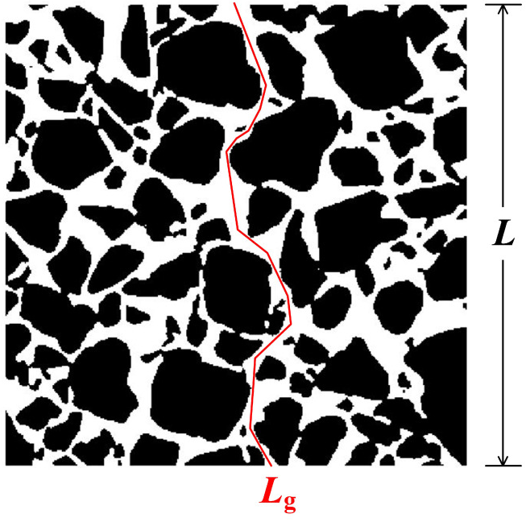
Analysis of binary microstructures
Features:
Porosity
Pore size distribution
Thickness distribution
Chord-length distribution
Local orientation
Tortuosity
…
Torquato (2002)
Hormann et al. (2016)

Slide 19
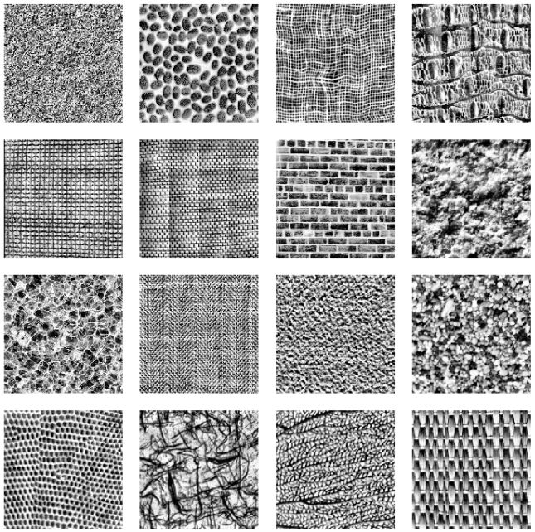
Image texture analysis
Structures of interest may be hard to identify or individualize
Poor resolution
Aggregation process
Superposition
…
Image texture analysis:
Study of the variations of gray levels between neighbour pixels

Slide 20
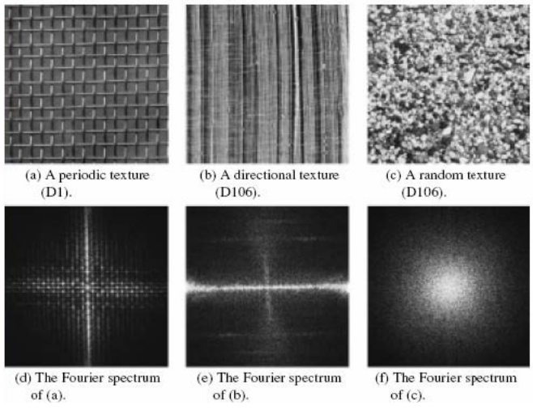
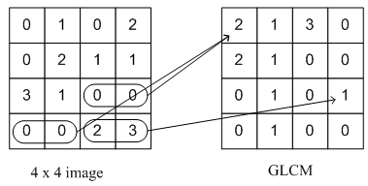
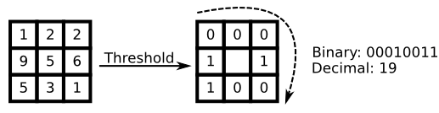
Image texture analysis methods
(Gray-level) co-occurrence matrix
“Haralick” features
Run-length matrix
Local binary patterns
Frequency Analysis
Fourier, Gabor, wavelets…
Auto-regressive models
Fractal analysis
Granulometry
(developed later)

Slide 21
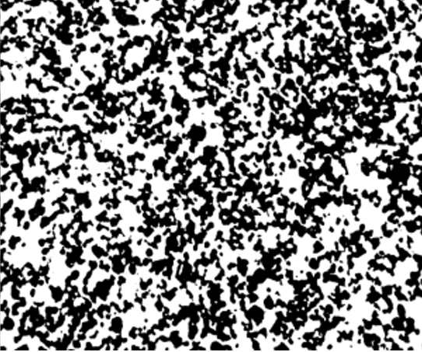
Typology of image analysis cases
Regions
Points
Microstructures
Textures
Features:
Size
Shape
Orientation
Intensities
…
Features:
Densities
[co]Localization
Repulsion / attraction
…
Features:
Porosity
Tortuosity
Thickness D°
Pore size D°
…
Features:
Variations of gray levels
Size D°
Orientation

Slide 22
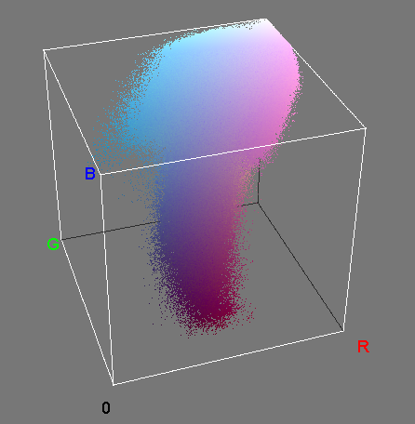
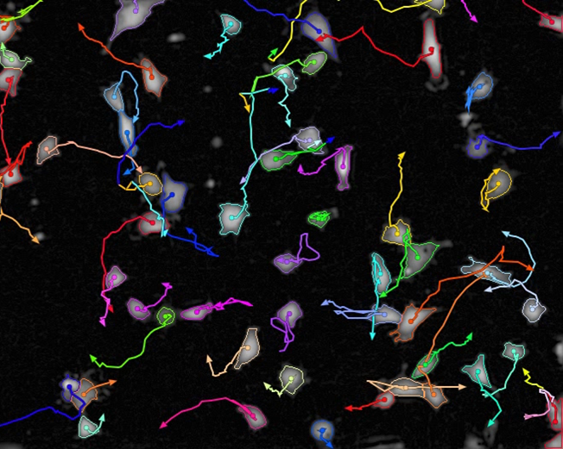
Typology of image analysis cases (continued)
Histogram analysis
Intensities / gray values
Multi-variate histograms
Colors
Joint histograms
Clustering / learning possible
Time-analysis
Changes of morphology / intensity…
Changes in localization
…

Slide 23
Outline
Introduction
What can we quantify?
How can we quantify?
Mathematical preliminaries
Perimeter & Surface area
Image texture analysis

Slide 24
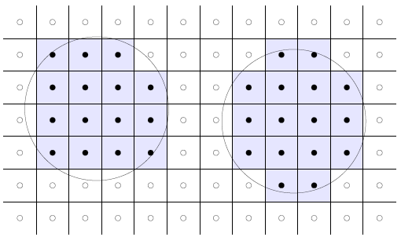
Digitization of images
Image space in “discrete” -> defined on a grid
Shape defined in continuous space will result in a representation in discrete space

Slide 25
Digitization of images
Gauss digitization:
Consider the pixels within structures
We may reconstruct structures
Polygons (2D)
Polyhedra (3D)
The same continuous shape may have several digitizations

Slide 26
Digitization of measures
Given a discrete representation of images, how do we evaluate geometric quantities?
Measure on reconstruction
Digitization of measures
…
Which error(s)?
How to validate?

Slide 27
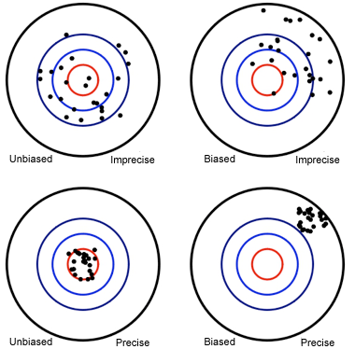
Evaluation of measures quality
Two criteria:
Accuracy
Precision (variability)
Measures
Bias (average error)
Standard deviation

Slide 28
Outline
Introduction
What can we quantify?
How can we quantify?
Mathematical preliminaries
Perimeter & Surface area
Image texture analysis

Slide 29
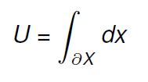
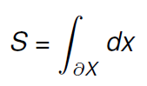
How can we quantify? Perimeter and Surface area
Widely used features
May be seen as the “quantity of boundary”
Determine several shape indices
Continuous definitions
Perimeter
Surface area
Discrete equivalent?

Slide 30



Starting example: how to measure perimeter?
Idea #1: count boundary pixels [voxels]
Do we improve measure if we increase resolution?

Slide 31

Surface area estimation
Count Border voxels
« Marching cubes »
Developed for 3D visualization of intensity images
Reconstruction of a triangle mesh based on 2x2x2 voxels configurations
Mesh surface area measure
Integral geometry
Discrete geometry
Lorensen W.E. and Cline H.E. (1987)
Coeurjolly D., Flin F. , Teytaud O. , Tougne L. (2002)

Slide 32


Perimeter estimation integral geometry approach
Principle:
Integration over all 2D lines:
All possible orientations
All parallel lines
Compute intersections (or Euler Number) of lines with region
Crofton formula relates perimeter to number of intersections
Crofton (1868)

Slide 33


Surface area estimation integral geometry approach
Extends very nicely to 3D case!
Integration over all 3D lines:
All possible orientations
All parallel lines
Crofton formula relates Surface area to number of intersections
Crofton (1868)

Slide 34

Surface area estimation integral geometry approach
Application to discrete 3D images:
Average over the 3 or 13 main directions
Express S as a sum of values computed over voxels
Or over 2x2x2 binary configurations
Very efficient algorithms
Serra, 1980 ; Ohser & Schladitz, 2009
Legland et al. 2007, Image Anal Stereol
Ziegel & Kiderlen, 2010

Slide 35








Experimental validation
3D shapes generation
Known / fixed surface area
Random orientation and position
3D gauss discretization
Various grid sizes
Cubic & non-cubic voxels

Slide 36

Comparison of methods
Repeat for many positions & orientations
Crofton method:
More precise
Using 13 directions reduces variability
Isosurface
Large bias
Low variability

Slide 37


Some properties of surface area (and perimeter)
Important properties (in continuous domain):
Invariance to isometries
translations & rotations
(not totally preserved in discrete space)
Additivity
Estimate from partial observation
Build estimators
Generalizes to binary microstructures
Also valid for:
volume, area, Euler number

Slide 38
Summary on perimeter & surface area
Obvious / naive methods are not always accurate…
Good idea to apply validation workflows
Not always easy to setup
-> we will see this during practical

Slide 39
Outline
Introduction
What can we quantify?
How can we quantify?
Mathematical preliminaries
Perimeter & Surface area
Image texture analysis
Gray level granulometry

Slide 40

Gray level granulometry - motivation
Plant tissue imaging
Whole section
Quasi-cellular resolution
Cells difficult to segment
Small cells, superposition
Objectives:
Quantify cell size distribution
And its spatial variations
Use image texture analysis
Gray level granulometry
Image: section of maize stem section

Slide 41


Gray level granulometry based on mathematical morphology
Principle: application of image filters with increasing sizes
Use of morphological opening / closing
Sum of gray levels within image
Morphological closing makes dark regions smaller than SE disappear

Slide 42

Gray level granulometry based on mathematical morphology
Principle: application of image filters with increasing sizes
Use of morphological opening / closing
Sum of gray levels within image
Morphological closing makes dark regions smaller than SE disappear
Compute “average size” within image:

Slide 43




Comparison of plant tissue sections
Variation of sum
of grey levels (%)
350 µm
10.7 mm
450 µm
Size of structuring element (µm)
Images: section of tomato pericarp
Devaux et al 2008, Postharvest Biol Tech.

Slide 44
Computation of average size profiles
Idea: measure texture within moving regions of interest
Summarize each granulometry curve by the average size
Plot the profile of average size

Slide 45

Computation of average size profiles
Cell mean grey size

Slide 46

Extensions to arbitrary regions
Legland et al. (2020)

Slide 47

Description of anisotropy

Slide 48




Extension to orientation mapping
Context: use of plant fibers within bio-based materials
Objective: quantify distribution of orientations
Method: granulometry with oriented line SE
Gager et al. (2020)

Slide 49
Gray-level granulometry summary
Quantitatively describe texture within an image
“Simple” method
Interpretation as size distribution
Focus on bright vs dark structures
Various flavours:
Global texture
Localisation of texture
Orientation
Further analyses often require multi-variate statistical data exploration

Slide 50
General conclusion
Quantitative image analysis is a rich topic!
Find the right feature for the right image
Region analysis is not the only option!
Be critical with quantitative results
Do not always blindly trust computers!
Validate image analysis methods

Slide 51
The end

Slide 52
References
Region analysis
Arganda-Carreras I, Andrey P (2017) Designing Image Analysis Pipelines in Light Microscopy: A Rational Approach. Markaki, Yolanda / Harz, Hartmann (Eds.) Light Microscopy: Methods and Protocols. Springer New York: New York, NY. p. 185-207
Iwata H, Ukai Y (2002) SHAPE: a computer program package for quantitative evaluation of biological shapes based on elliptic Fourier descriptors. J Hered , Vol. 93, No. 5, p. 384-385
Vergara HM, Pape C, Meechan et al. (2021) Whole-body integration of gene expression and single-cell morphology. Cell, 184, 4819-4837.e22
Zinchenko V, Hugger J, Uhlmann V, Arendt D, Kreshuk A (2023) MorphoFeatures for unsupervised exploration of cell types, tissues, and organs in volume electron microscopy. eLife, eLife Sciences Publications, Ltd, 12, e80918
Legland, D. & Beaugrand, J. (2013) Automated clustering of lignocellulosic fibres based on morphometric features and using clustering of variables. Industrial Crops and Products, 45, 253 – 261.
Point pattern analysis
Cressie, Noel A. (1991) Statistics for spatial data. John Wiley and Sons.
Lagache T, Lang G, Sauvonnet N, Olivo-Marin JC (2013) Analysis of the spatial organization of molecules with robust statistics. PLOS ONE, Vol. 8(12) 1-7.
Legland, D.; Devaux, M.-F. & Guillon, F. (2014) Statistical mapping of maize bundle intensity at the stem scale using spatial normalisation of replicated images. PLoS ONE, 9, e90673
Behanova A, Klemm A and Wählby C (2022) Spatial Statistics for Understanding Tissue Organization. Front. Physiol. 13:832417. doi: 10.3389/fphys.2022.832417.

Slide 53
References
Microstructure
Torquato S (2002) Random Heterogeneous Materials: Microstructure and Macroscopic Properties, Springer, New York.
Doube M et al. (2010) BoneJ: free and extensible bone image analysis in ImageJ. Bone, Vol. 47, No. 6 p. 1076-1079.
Feeney E, Lamichhane P, Sheehan JJ (2021) The cheese matrix: understanding the impact of cheese structure on aspects of cardiovascular health – a food science and a human nutrition perspective. International Journal of Dairy Technology , Vol. 74, No. 4 p. 656-670
Hormann K, Baranau V, Hlushkou D, Holtzel A, Tallarek U (2016) Topological analysis of non-granular, disordered porous media: determination of pore connectivity, pore coordination, and geometric tortuosity in physically reconstructed silica monoliths. New J. Chem.
Silva, J. V. C.; Legland, D.; Cauty, C.; Kolotuev, I. & Floury, J. (2015) Characterization of the microstructure of dairy systems using automated image analysis. Food Hydrocolloids, 44, 360-371
Texture analysis
Haralick RM (1979) Statistical and structural approaches to texture. Proc. IEEE , Vol. 67(5) p. 786-804

Slide 54
References
Perimeter / Surface area
Serra, J. (1982) Image Analysis and Mathematical Morphology. Volume 1. Academic Press
Lorensen WE & Cline, HE (1987) Marching Cubes: A High Resolution 3D Surface Construction Algorithm. Proceedings of the 14th Annual Conference on Computer Graphics and Interactive Techniques, ACM, 163-169
Coeurjolly D, Flin F, Teytaud O & Tougne L (2002) Multigrid convergence and surface area estimation. Geometry, Morphology, . . . LNCS 2616, 2002, 2616, 101-119
Ohser, J. & Schladitz, K. (2009) 3D Images of Materials Structures. WILEY-VCH Verlag GmbH & Co. KGaA, Weinheim
Legland, D.; Kiêu, K. & Devaux, M.-F. (2007) Computation of Minkowski measures on 2D and 3D binary images. Image Analysis and Stereology, 26, 83-92
Lehmann, G. & Legland, D. (2012) Efficient n-dimensional surface estimation using crofton formula and run-length encoding. The Insight Journal
Ziegel, J. & Kiderlen, M. (2010) Estimation of surface area and surface area measure of three-dimensional sets from digitizations. Image and Vision Computing, 28, 64-77

Slide 55
References
Granulometry analysis
Serra, J. (1982) Image Analysis and Mathematical Morphology. Volume 1. Academic Press
Soille, P. (2003) Morphological Image Analysis. Springer.
Devaux, M.-F.; Bouchet, B.; Legland, D.; Guillon, F. & Lahaye, M. (2008) Macro-vision and grey level granulometry for quantification of tomato pericarp structure. Postharvest Biol. and Technol., 47, 199-209
Legland, D.; Devaux, M.-F.; Bouchet, B.; Guillon, F. & Lahaye, M. (2012) Cartography of cell morphology in tomato pericarp at the fruit scale. J. Microscopy, 247, 78-93
Devaux, M.-F. & Legland, D. (2014) Grey level granulometry for histological image analysis of plant tissues. In: Microscopy: advances in scientific research and education. Méndez-Vilas, A. (Ed.) Formatex Research Center, 2014, 681-688
Gager V, Legland D, Bourmaud A, Le Duigou A, Pierre F, Behlouli K & Baley C (2020) Oriented granulometry to quantify fibre orientation distributions in synthetic and plant fibre composite preforms. Industrial Crops and Products, 152, 112548
Legland, D.; Guillon, F. & Devaux, M.-F. (2020) Parametric mapping of cellular morphology in plant tissue sections by gray level granulometry. Plant Methods, 2020, 16, 63

